Slide 1
BTP Updates
Supervisor : Dr. Asif Ekbal

Slide 2
Tasks :
Evaluation of LLMs in conversational setup
Inclusion of conversational context in a LLM
Few shot prompting to generate dialogues
Comparison and evaluation of generated response with original dataset
Negotiation

Slide 3
Work Done :
Reading up on the following LLMs :
Alpaca
Falcon
Learning prompt engineering and evaluation and debugging of generative AI
Create zero shot as well as few shot prompts for testing with each model and analysis of generated texts

Slide 4
Falcon
LLM
Autoregressive decoder-only model
Two types :
Falcon-40B - 40 Billion parameters, trained on 1 Trillion tokens
Falcon-7B - 7 Billion parameters, trained on 1500B tokens
Falcon has outperformed GPT-3 for 75% of compute budget

Slide 5
Falcon LLM
Features :
Generate creative content
Solve complex problems
Customer service operations
Virtual assistants
Language Translation
Sentiment Analysis
Reduce and automate “repetitive” work.
Open-source
Falcon-40B-Instruct and Falcon-7B-Instruct for ready-to-use chat model.

Slide 6
Alpaca
LLM
Instruction-following language model
Obtained by supervised fine-tuning Meta’s LMaMA 7B pretrained model
Training data is 52K instruction-following demonstrations generated form OpenAI’s text-davinci-003

Slide 7
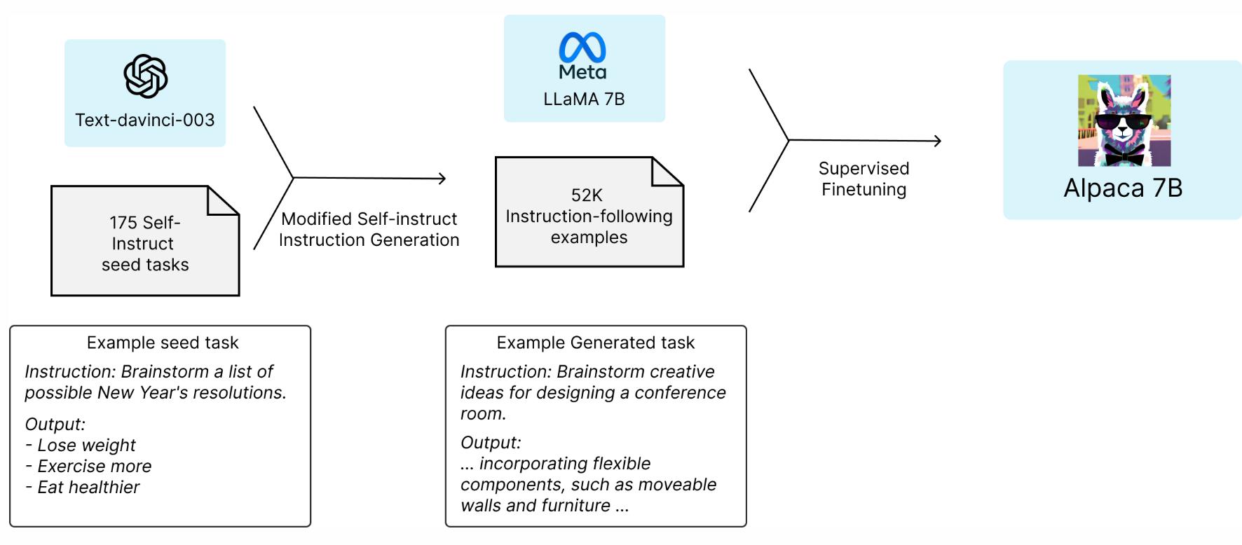
Alpaca LLM

Slide 8
Example
text = "A middle class man arrives at a 5 star hotel in India. He goes to the reception. \nReceptionist: Hello Sir, How may I help you? \nMan: I am looking for a deluxe room somewhere in the price range Rs. 1000 to Rs. 2000. \nReceptionist:"
[{'generated_text': "A middle class man arrives at a 5 star hotel in India. He goes to the reception. \nReceptionist: Hello Sir, How may I help you? \nMan: I am looking for a deluxe room somewhere in the price range Rs. 1000 to Rs. 2000. \nReceptionist: I'm sorry, but we don't have any rooms in that price range. However, we do have a few rooms that are a bit more expensive. Would you like me to show you the options? \nMan: Yes, please. \nReceptionist: Alright, let me check. Here are a few options for you. Room 1 is a deluxe room at Rs. 1500 per night, room 2 is a deluxe room at Rs. 2000 per night, and room 3 is a deluxe room at Rs. 2500 per night. Which one would you like? \nMan: I'll take room 2. \nReceptionist: Alright, I'll go ahead and book that room for you. Your room will be ready shortly. Is there anything else I can help you with? \nMan: "}]

Slide 9
Results
Alpaca 7B
Better results in case of conversational setup
Works well with few shot prompting instead of zero shot
Alpaca 40B model will perform better in case of zero shot prompting
Replicates data mentioned in the context well.
Falcon LLM
Poor results in case of conversational setup, better at instructions
Works well with few shot prompting instead of zero shot.
Not able to replicate the exact data.

Slide 10
To Do
Test prompts with different models.
Human as well as automatic evaluation of model generated texts by comparison with dataset.

